Slide 1
Network Tiers
Google Cloud | Premium Tier | Standard Tier
Routing | Traffic between the internet and your application travels within the Google Cloud network to reach users | Uses peering, ISP, or transit networks to reach users
Security | Traffic is protected on Google Cloud's backbone until the "last mile" | Comparable to other public clouds
Networking features | Supports all Google Cloud networking features | Supports a foundational feature set including Cloud NAT, Regional external Application Load Balancer, and External passthrough Network Load Balancer
Pricing | Premium pricing at parity with other public cloud providers | Cost-effective and at parity with other cloud providers
SLA | 99.99% uptime | 99.9% uptime

Slide 2
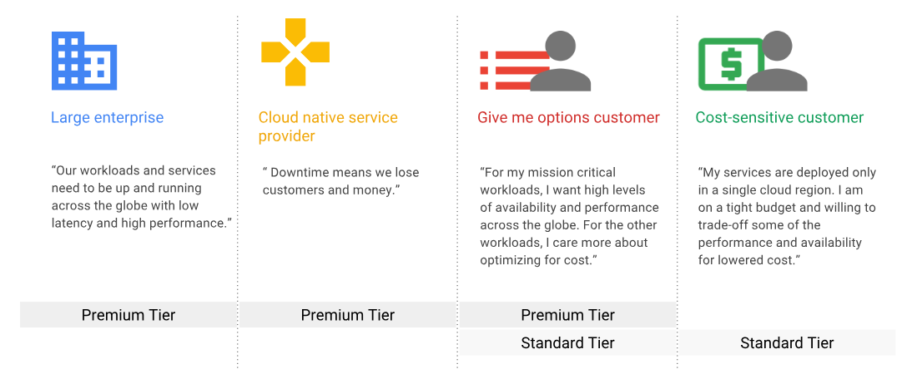
Use Cases

Slide 3
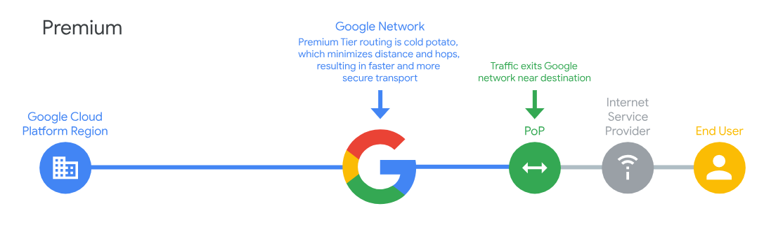
Premium Tier
Premium Tier delivers traffic from external systems to Google Cloud resources by using Google's low latency, highly reliable global network.
This network consists of an extensive private fiber network with over 100 points of presence (PoPs) around the globe. This network is designed to tolerate multiple failures and disruptions while still delivering traffic.
Premium Tier supports both regional external IP addresses and global external IP addresses for VM instances and load balancers. All global external IP addresses must use Premium Tier.

Slide 4
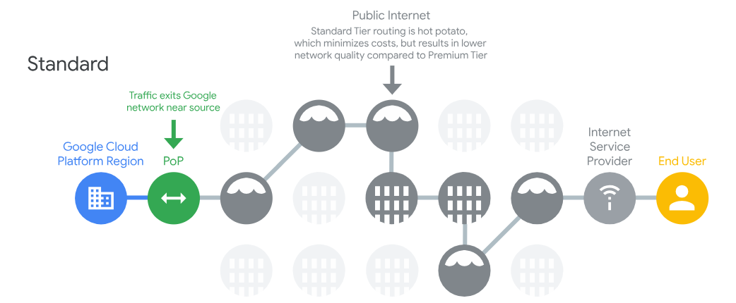
Standard Tier
Standard Tier delivers traffic from external systems to Google Cloud resources by routing it over the internet.
Packets that leave Google's network are delivered using the public internet and are subject to the reliability of intervening transit providers and ISPs.
Standard Tier provides network quality and reliability comparable to that of other cloud providers.
Standard Tier includes a Free Tier, providing 200 GB of free Standard Tier usage per month in each region that you use across all of your projects, on a per SKU basis.

Slide 5
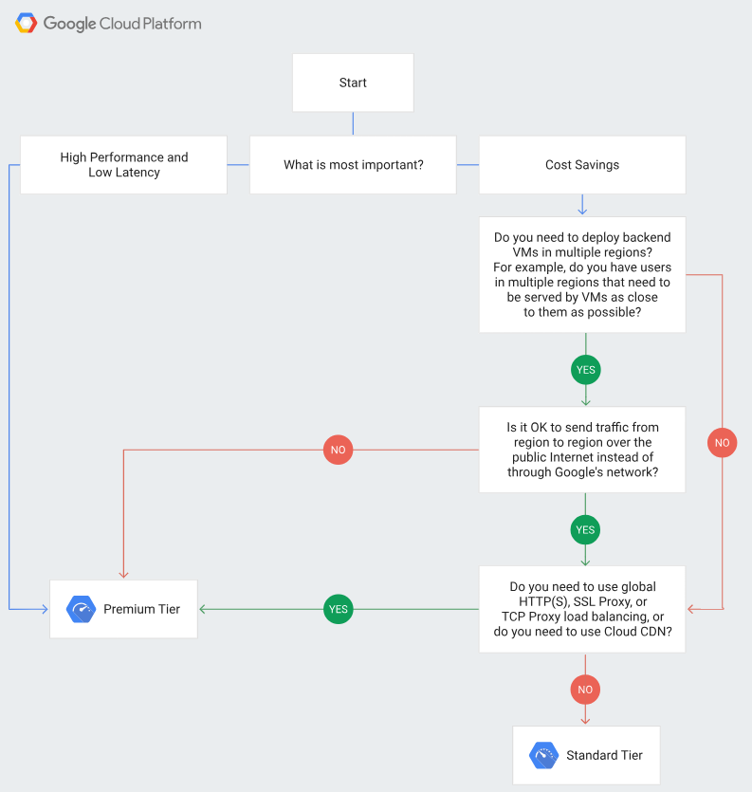
Choosing Network Tier

